Slide 1
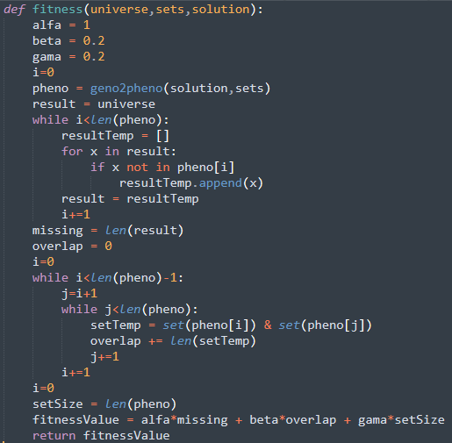
Variável universe
(1, 2, 3, 4) -> c-use de universe

Slide 2
Variável sets
(1, 2, 3) -> c-use de sets

Slide 3
Variável solution
(1, 2, 3) -> c-use de solution

Slide 4
Variável alfa
(2, 3, 4, 5, 11, 12, 17) -> c-use de alfa

Slide 5
Variável beta
(2, 3, 4, 5, 11, 12, 17) -> c-use de beta

Slide 6
Variável gama
(2, 3, 4, 5, 11, 12, 17) -> c-use de gama

Slide 7
Variável i
(2, 3, 4, 5, 6) -> p-use de i
(2, 3, 4, 5, 11) -> p-use de i
(2, 3, 4, 5, 6, 7, 8, 9) -> p-use de i
(2, 3, 4, 5, 6, 7, 10) -> c-use de i
(10, 5, 6) -> p-use de i
(10, 5, 11) -> p-use de i
(10, 5, 6, 7, 8, 9) -> p-use de i
(10, 5, 6, 7, 10) -> c-use de i
(11, 12, 17) -> p-use de i
(11, 12, 13) -> p-use de i, seguido de um c-use de i
(11, 12, 13, 14, 15) -> c-use de i
(11, 12, 13, 14, 16) -> não executável
(16, 12, 17) -> p-use de i
(16, 12, 13) -> p-use de i, seguido de um c-use de i
(16, 12, 13, 14, 15) -> c-use de i
(16, 12, 13, 14, 16) -> não executável
Anomalia do tipo 3 no nó 17 (definido, mas não usado)

Slide 8
Variável pheno
(3, 4, 5, 6) -> p-use de pheno
(3, 4, 5, 11) -> p-use de pheno
(3, 4, 5, 6, 7, 8, 9) -> p-use de pheno
(3, 4, 5, 11, 12, 17) -> p-use de pheno, seguido de c-use de pheno
(3, 4, 5, 11, 12, 13) -> não executável
(3, 4, 5, 11, 12, 13, 14, 16) -> não executável
(3, 4, 5, 11, 12, 13, 14, 15) -> não executável

Slide 9
Variável result
(4, 5, 6, 7, 8) -> p-use de result
(4, 5, 6, 7, 10) -> p-use de result
(10, 5, 6, 7, 8) -> p-use de result
(10, 5, 11) -> c-use de result
(4, 5, 11) -> c-use de result

Slide 10
Variável resultTemp
(6, 7, 8, 9) -> c-use de resultTemp
(9, 7, 10) -> c-use de resultTemp
(9, 7, 8, 9) -> c-use de resultTemp
(6, 7, 10) -> c-use de resultTemp

Slide 11
Variável missing
(11, 12, 17) -> c-use de missing
(11, 12, 13, 14, 16, 12, 17) -> não executável

Slide 12
Variável overlap
(11, 12, 13, 14, 15) -> c-use de overlap
(15, 14, 16, 12, 17) -> c-use de overlap
(11, 12, 13, 14, 16, 12, 17) -> não executável
(11, 12, 17) -> c-use de overlap

Slide 13
Variável j
(13, 14, 16) -> não executável
(13, 14, 15) -> p-use de j, seguido de c-use de j
(15, 14, 15) -> c-use de j
(15, 14, 16) -> p-use de j

Slide 14
Variável setTemp
(15) -> c-use de setTemp

Slide 15
Variável setSize
(17) -> c-use de setSize

Slide 16
fitnessValue -> Só usado no return

Slide 17
Paths Completos:
1, 2, 3, 4, 5, 11, 12, 17, 18
1, 2, 3, 4, 5, 6, 7, 8, 9, 7, 10, 5, 11, 12, 17, 18
1, 2, 3, 4, 5, 6, 7, 10, 5, 6, 7, 10, 5, 11, 12, 13, 14, 15, 14, 16, 12, 17, 18
1, 2, 3, 4, 5, 6, 7, 8, 9, 7, 10, 5, 6, 7, 8, 9, 7, 10, 5, 6, 7, 8, 9, 7, 10, 5, 11, 12, 13, 14, 15, 14, 15, 14, 16, 12, 13, 14, 15, 14, 16, 12, 17, 18
1, 2, 3, 4, 5, 6, 7, 8, 9, 7, 8, 9, 7, 10, 5, 11, 12, 17, 18
Inputs e Outputs Esperados:
P1: (universe = [], sets = [], solution = []) -> fitnessValue = 0
P2: (universe = [1], sets = [ [], [1] ], solution = [1, 0]) -> fitnessValue = 1.2
P3: (universe = [], sets = [ [], [] ], solution = [1, 1]) -> fitnessValue = 0.4
P4: (universe = [1], sets = [ [], [], [], [1] ], solution = [1, 1, 1, 0]) -> fitnessValue = 1.6
P5: (universe = [1, 2], sets = [ [], [1, 2] ], solution = [1, 0]) -> fitnessValue = 2.2

